Slide 1
Nexperia Final report
By Huang Kaiyi

Slide 2
outline
Kaggle contest
Different networks (ResNet, VGG, STN, attention)
Finding problems: noisy labels, domain adaptation
Different loss functions (CE, SAT, FL, ensemble, etc.)
Data preprocessing (crops, random erase, salt-and-pepper noise, sharpener, etc.)

Slide 3
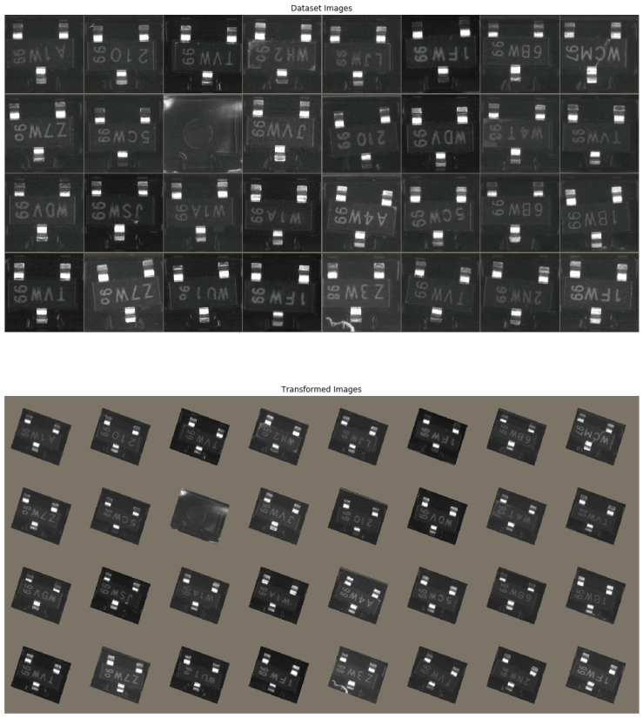
Spatial transformer networks (STN)
Learn to predict region of interest and align the same object to the same angle (rotation), magnitude (scaling), and position (translation)
Motivation: to obtain humans ability to recognize the a familiar object regardless of its variations

Slide 4
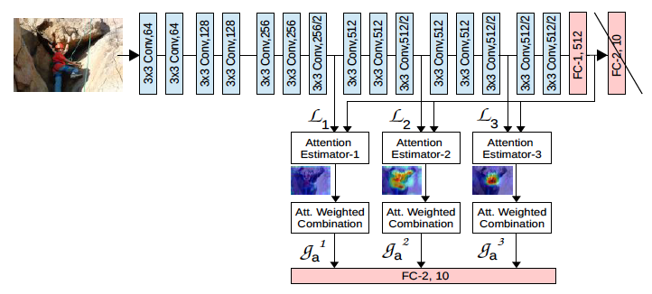
Attention map
Insert attention networks amid conv layers and output feature maps
Combine the feature maps (L) with the last vector (G) before the last fully connected layer and pass it through the classifier, so high resolution features are preserved till the end
Each L acting on G learns regions of interest by returning an attention map (A)

Slide 5
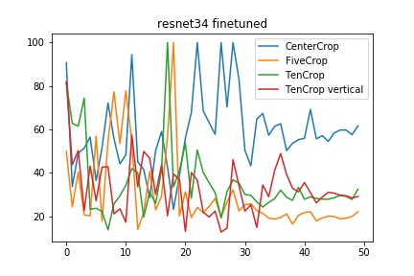
different crop styles FPR curves
Initial model:
ResNet34 pretrained on ImageNet
Crop styles:
Applied on train, validation, and test datasets
curves:
Test FPR

Slide 6
Noisy labels
Noisy labels are all in good images
Noisy labels overfit later (doomed to overfit)
Defect image data are learned later

Slide 7
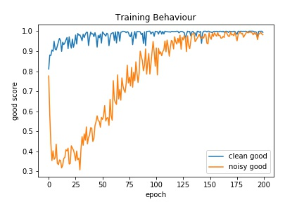
clean and noisy labels training

Slide 8
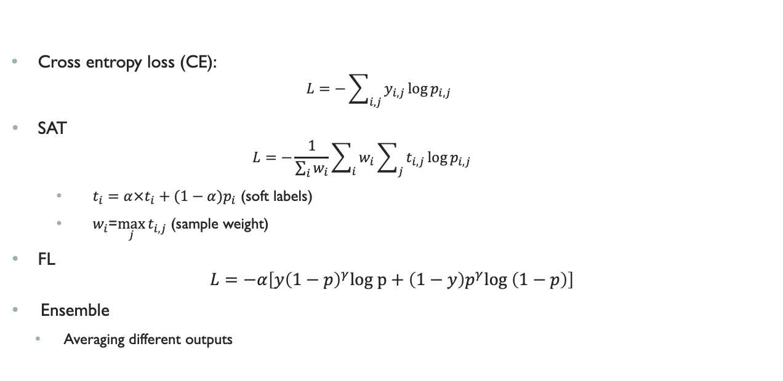
losses
Cross entropy loss (CE):
$$L=−\sum_{i,j}{y_{i,j}\log{p_{i,j}}}$$
SAT
$$L=−\frac{1}{\sum_{i}{w_{i}}}\sum_{i}{w_{i}\sum_{j}{t_{i,j}\log{p_{i,j}}}}$$
$t_{i}=α×t_{i}+(1−α)p_{i}$ (soft labels)
$w_{i}$=$\max_{j}{t_{i,j}}$ (sample weight)
FL
$$L=−α\left[y{\left(1−p\right)}^{γ}log p+\left(1−y\right)p^{γ}log \left(1−p\right)\right]$$
Ensemble
Averaging different outputs

Slide 9
 |  | Jan |  | Feb | Mar
corrected |  | Yes | No | NA | NA
AUC (%) | CE | 95.28 | 92.81 | 95.39 | 93.60
 | FL | 93.59 | 91.47 | 94.21 | 92.95
 | SAT | 93.70 | 92.45 | 94.60 | 93.54
 | Ensemble | 94.69 | 93.17 | 95.24 | 94.11
FPR (TPR=98%) | CE | 55.21 | 69.80 | 58.83 | 70.71
 | FL | 71.09 | 81.01 | 62.81 | 67.70
 | SAT | 69.54 | 84.12 | 63.07 | 72.65
 | Ensemble | 60.86 | 76.09 | 56.12 | 66.28
Threshold (TPR=98%) (10-2) | CE (10-5) | 3.66 | 2.16 | 6.47 | 7.31
 | FL | 0.89 | 0.73 | 1.40 | 1.45
 | SAT | 7.44 | 6.91 | 8.99 | 9.70
 | Ensemble | 2.98 | 2.76 | 3.73 | 3.95
SAT did not stand out compared to CE
Ensemble has the best result on Feb and March data (better than all the individual algorithms rather than an averaging effect)

Slide 10
Take away messages
Learn from existing models and code!
Try different models and loss functions
Ensembles improve overall results.
Data preprocessing such as random erase, sharpener, and pepper-and-salt noise is effective.
Experiments matter most!

